Slide 1
Corporative Network
Uva 1329, LA 3027
Time: 3 seconds

Slide 2
Problem Descriptions(1/3)
A very big corporation is developing its corporative network. In the beginning each of the N enterprises of the corporation, numerated from 1 to N, organized its own computing and telecommunication center.
Soon, for amelioration of the services, the corporation started to collect some enterprises in clusters, each of them served by a single computing and telecommunication center as follow.

Slide 3
Problem Descriptions(2/3)
The corporation chose one of the existing centers I (serving the cluster A) and one of the enterprises J in some other cluster B (not necessarily the center) and link them with telecommunication line.
The length of the line between the enterprises I and J is |I −J|(mod 1000).
In such a way the two old clusters are joined in a new cluster, served by the center of the old cluster B.

Slide 4
Problem Descriptions(3/3)
Unfortunately after each join the sum of the lengths of the lines linking an enterprise to its serving center could be changed and the end users would like to know what is the new length.
Write a program to keep trace of the changes in the organization of the network that is able in each moment to answer the questions of the users.
Your program has to be ready to solve more than one test case.

Slide 5
Input
The first line of the input file will contains only the number T of the test cases.
Each test will start with the number N of enterprises (5 ≤ N ≤ 20000).
Then some number of lines (no more than 200,000) will follow with one of the commands:
The test case finishes with a line containing the word ‘O’.
The ‘I’ commands are less than N.

Slide 6
Output
The output should contain as many lines as the number of ‘E’ commands in all test cases with a single number each — the asked sum of length of lines connecting the corresponding enterprise with its serving center.

Slide 7
Sample Input / Output
|2-5|=3
center
1
2
5
center
1
5
E 3
I 3 1
I 5 2
E 3
I 1 2
E 3
I 2 4
E 3
E 5
O
Number of test case
|1-3|=2
0
2
3
5
5
Number of enterprise
3
4
Make servine center from 3 to 1
|1-2|=1
|2-5|=3
1
2
5
center
|1-3|=2
3
4
Commands
|2-1|=1
|2-5|=3
1
2
5
|1-3|=2
|4-2|=2
center
End of test case
3
4

Slide 8
Set Representation
S1={0, 6, 7, 8}, S2={1, 4, 9}, S3={2, 3, 5}
Two operations considered here
Disjoint set union :
ex: S₁ ∪ S₂={0,6,7,8,1,4,9}
Find(i) : Find the set containing the element i. ex: Find(3) ∈ S₃, Find(8) ∈ S₁
0
4
2
6
7
8
1
9
3
5
S_{i} ∩ S_{j} = φ

Slide 9
Set Representation
Union and Find Operations
Make one of trees a subtree of the other
4
0
0
1
9
6
7
8
4
9
6
7
8
1
Possible representation for S1 union S2
S1={0, 6, 7, 8}, S2={1, 4, 9}

Slide 10
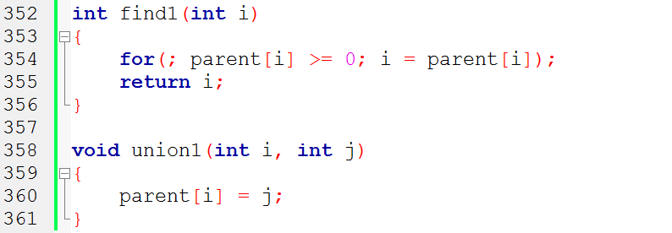
Array Set Representation
4
1
9
S1={0, 6, 7, 8}, S2={1, 4, 9}, S3={2, 3, 5}
0
i
[0]
[1]
[2]
[3]
[4]
[5]
[6]
[7]
[8]
[9]
6
7
8
parent
-
4
4
-
3
2
-
3
2
0
0
0
4
2
3
5

Slide 11
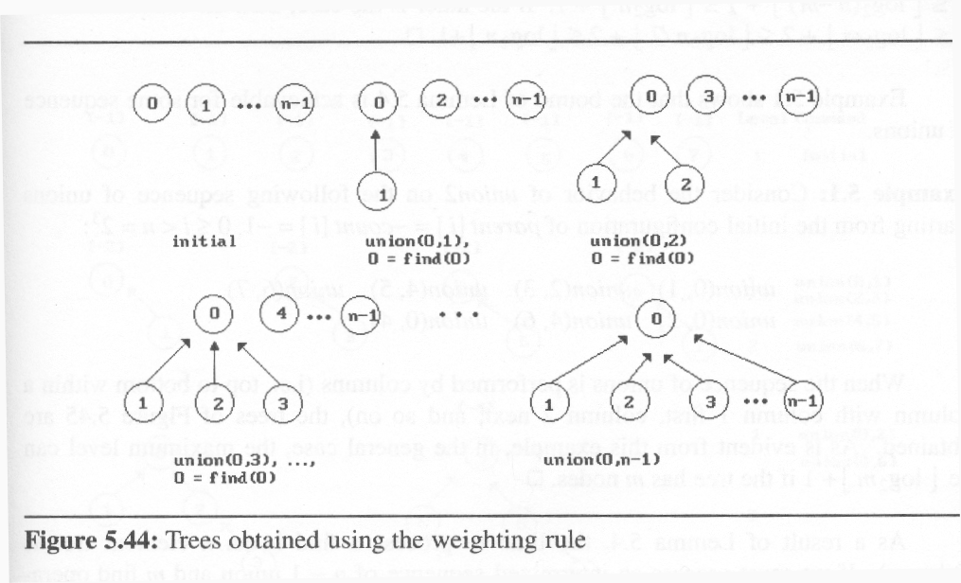
Set Representation
weighting rule for union(i,j):
If (no. of nodes in i) < (no. of nodes in j) then i (少) → j (多)
2
1
3
1

Slide 12
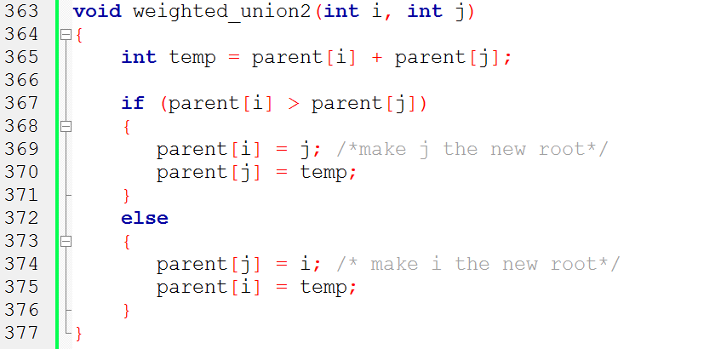
Modified Union Operation

Slide 13
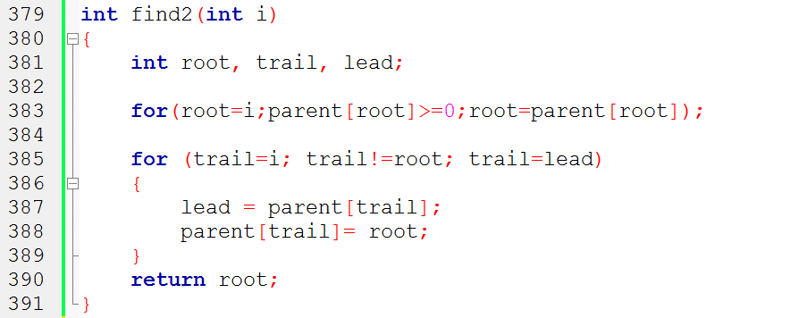
Modified Find(i) Operation
parent[root]==-8
root==0
0
root==4
1
2
4
If j is a node on the path from
i to its root then make j a child
of the root
root==6
3
5
6
lead==6
root==7
i==7
trail==7
7

Slide 14
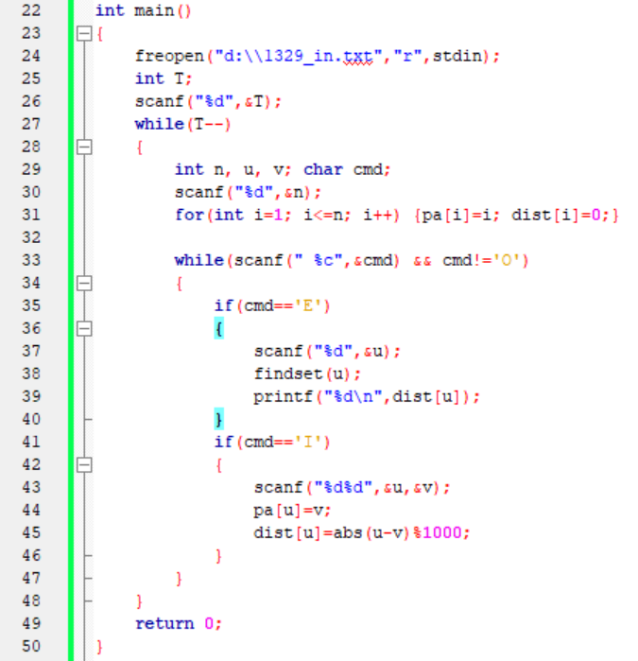

Slide 15
Observations (1/2)
Center
Center
dist[y]
dist[v]+L
v
dist[v]
v
Enterprise
L
Center
u
Enterprise
u
dist[u]=0
dist[u]=dist[v]+L
x
x

Slide 16
Observations (2/2)
Center
dist[y]
dist[v]+L
v
Enterprise
L
Enterprise
u
dist[x]
dist[u]=dist[v]+L
x
dist[x]=dist[x]+dist[u]

Slide 17
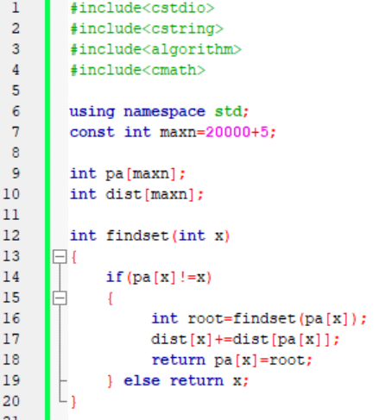
pa[x]
x=8
8
dist[8]=0
pa[x]=8
2
6
pa[x]
x=6
dist[6]=2
4
root=8
pa[x]=8
2
pa[x]
x=2
dist[2]=6
3
root=8
pa[x]=8
5
x=5
dist[5]=9
root=8
pa[x]=8

